Slide 1

Game AI Intro Simon Lucas

Slide 2
Game AI
Given an interesting and complex situation (perhaps with incomplete or incorrect information)
What shall I do next?
There is increasing potential to Game AI for real-world decision making…

Slide 3
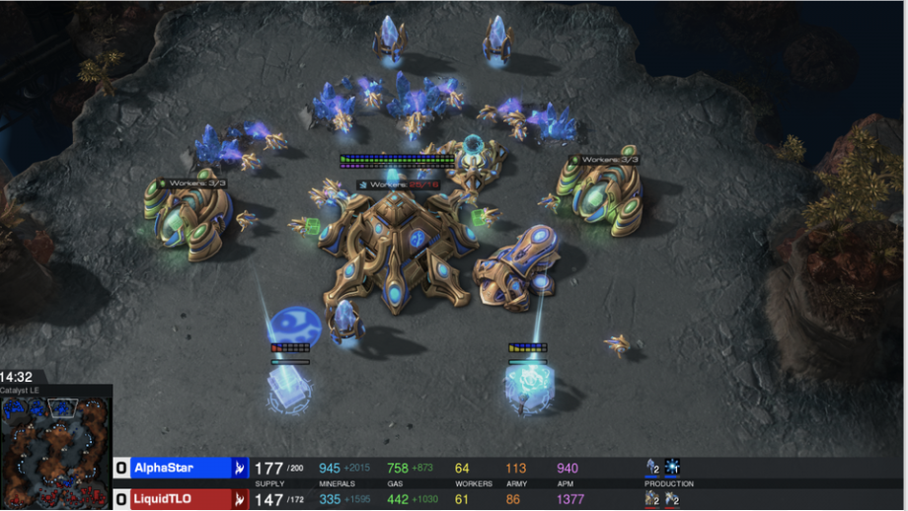
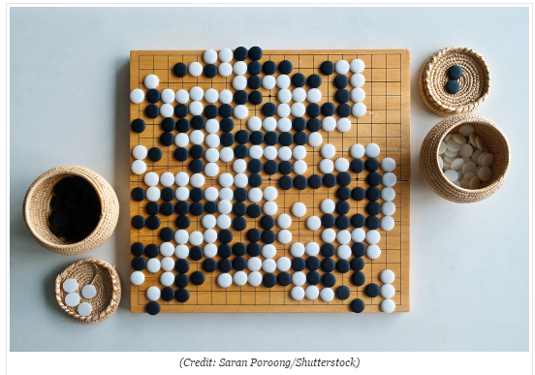
Recent Progress in Game AI…
Go
Poker
StarCraft
General Video Game AI
Notes:
Go is thought to be at least 3,000 years old
Recent progress in game AI has demonstrated that given enough data or experience, machines can rival or surpass even the most skilled human decision makers in a number of complex domains. There is now a clear need and opportunity to apply modern AI to military decision-making problems including operational planning.
In particular, I’ll describe how statistical forward planning algorithms can be used to make intelligent actions in a range of environments or to help inform human decision makers. This will help to avoid unforeseen consequences and might even make the world a better place!

Slide 4
Deep Reinforcement Learning
For
Does not require a fast forward model
Learns to act through experience
Can achieve amazing play strength given the right problem and sufficient engineering effort (e.g. AlphaZero)
Against
Long training times
Poor adaptability: learned strategies may be brittle (can be broken by small changes in environment)
Not very explainable (though not a total black box)

Slide 5
Challenges
Rapid learning
Dealing with large numbers of actors
Open-ended decision spaces
Partial observability
Of state, beliefs, objectives
Statistical Forward Planning (SFP) algorithms offer a general solution

Slide 6
Is Statistical Forward Planning the next Deep Learning?
But more explainable …

Slide 7
Statistical Forward Planning
Explainable?
watch the simulated outcomes
Tunable:
Tune sequence length for far-sightedness
Tune nEvals for thoroughness
Tune shift-buffer for consistency

Slide 8
Adding SFP AI: you need to implement:
public interface AbstractGameState { AbstractGameState copy(); AbstractGameState next(int[] actions); int nActions(); double getScore(); boolean isTerminal(); }
Notes:
Here’s what you need to do to add this magic AI to your game or system: the ones to be careful with are copy and next

Slide 9
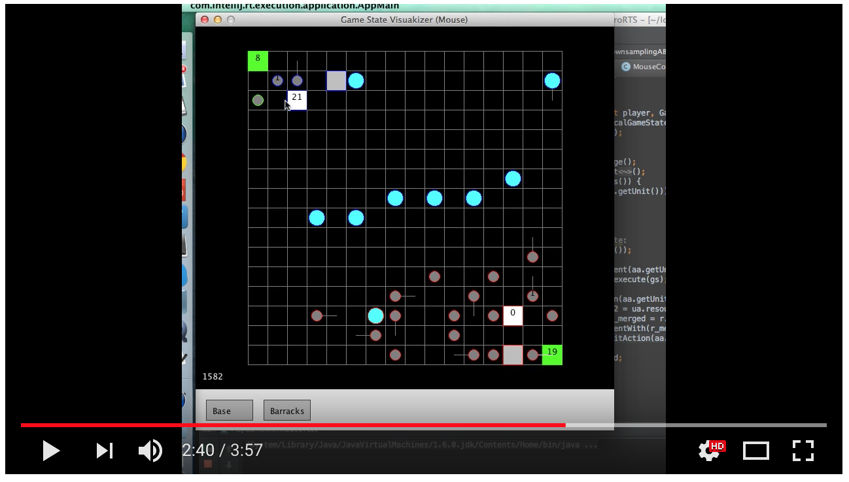
microRTS– another excellent challenge – branching factor of around 50,000

Slide 10
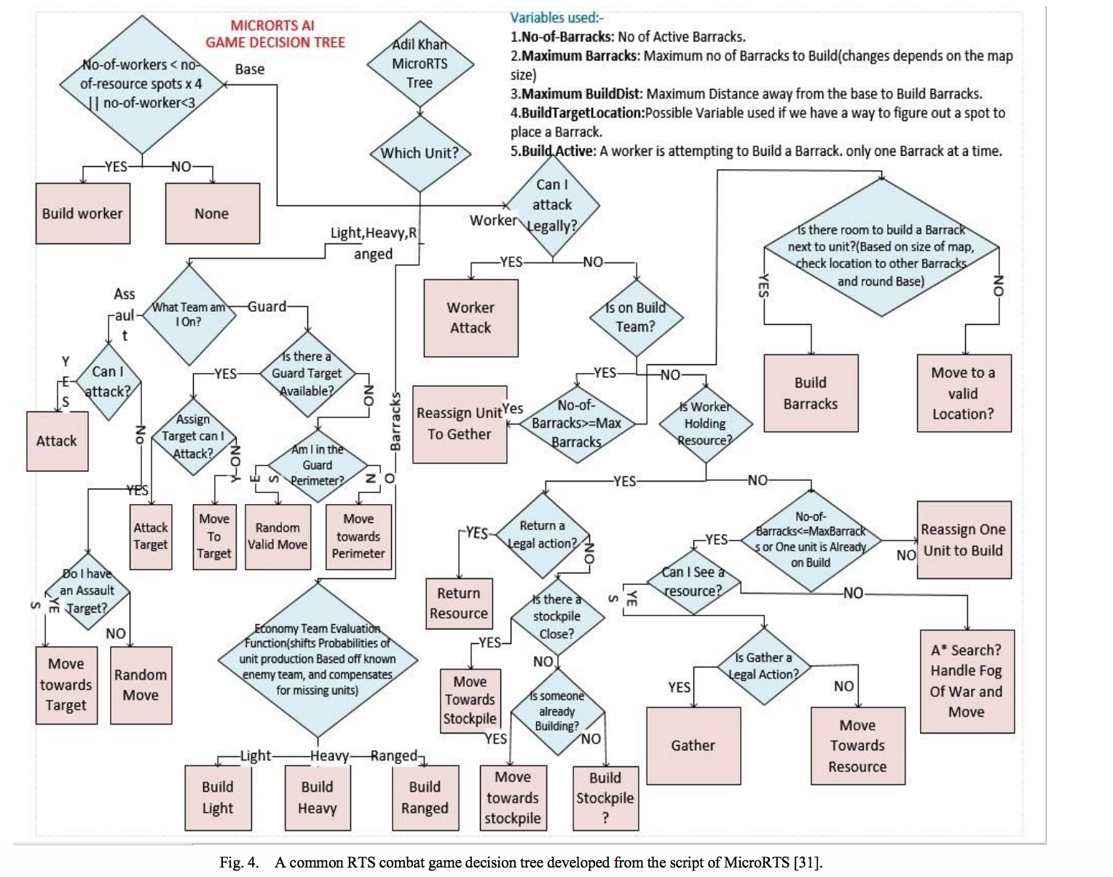
Best approach? Hand-coded versus SFP v. Deep RL / ?

Slide 11
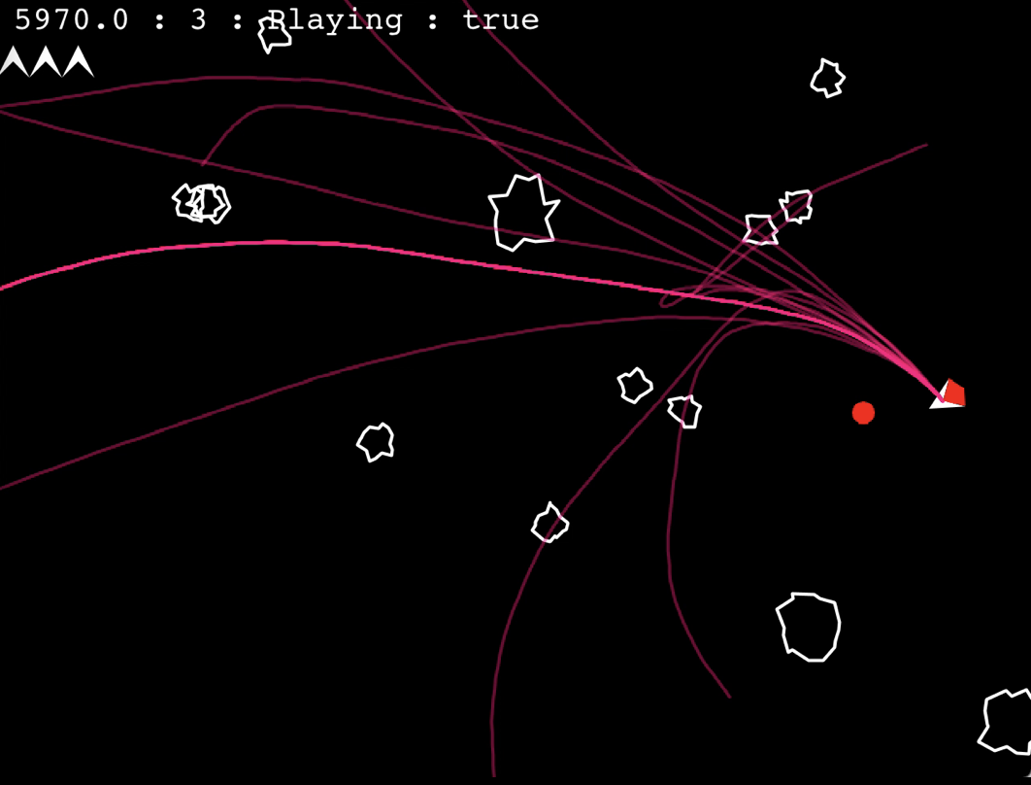
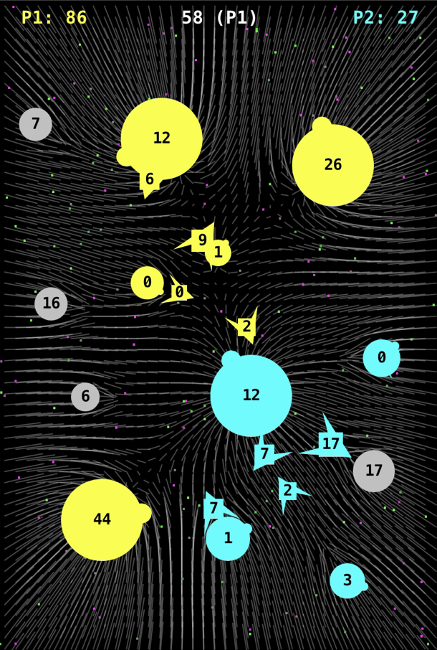
General and Rapidly adaptive AI
Need to be able to copy the system state
And rapidly advance it
Rule of thumb for video games: > 1000 simulation ticks per decision

Slide 12
Statistical Simulation based AI Forward model + SFP = Powerful AI
Relies on fast forward model:
Aim to run this 1000 x real-time
(actually 100 x or 10 x may be enough …)
F(s,a)-> s’
Deals with collaborators and adversaries

Slide 13
Creating and Searching Search Spaces

Slide 14
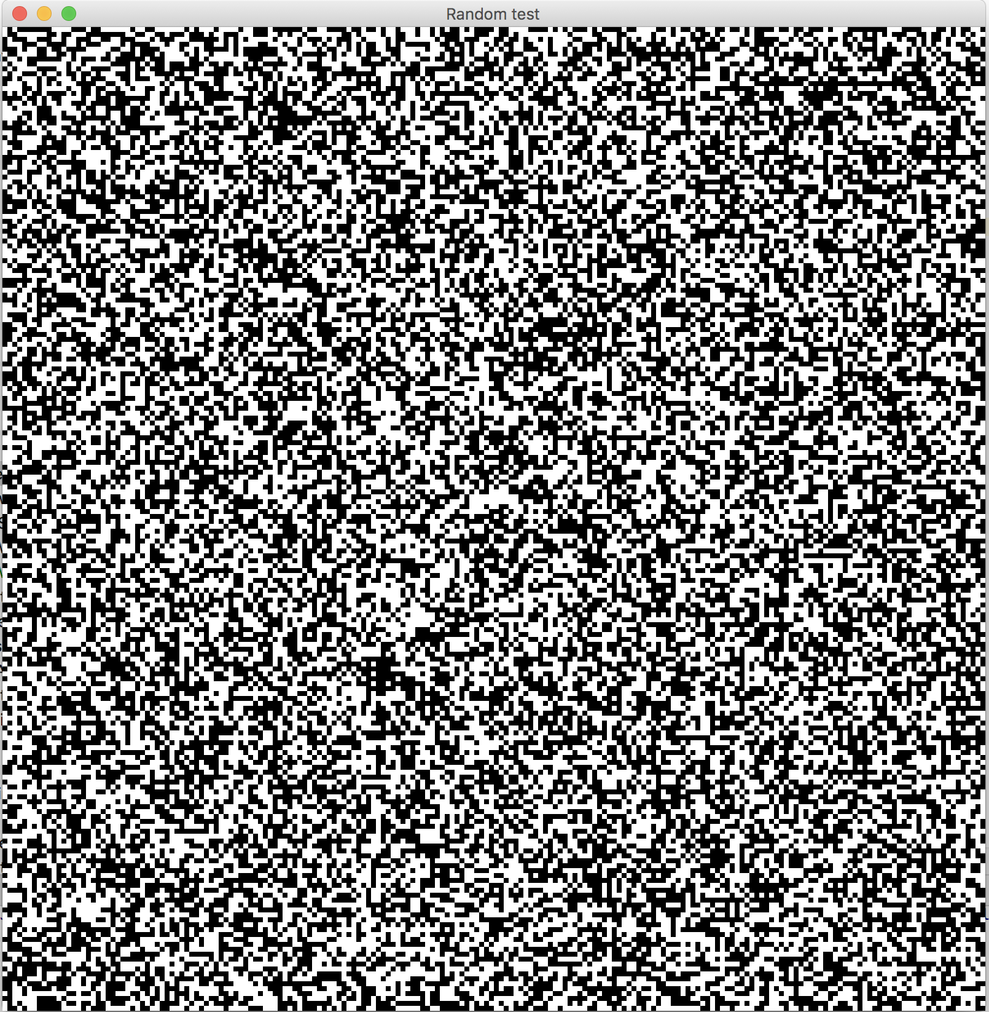
Search Space Example: Images
This is a 200 x 200 binary image
Hence it has 40,000 pixels
Each one is either black or white
How many possible images are there of this type?

Slide 15
The answer is:
2^{40,000}

Slide 16

Creating Chaos from order is EASY!
Notes:
Dice image related to games and to random evolutionary processes…

Slide 17
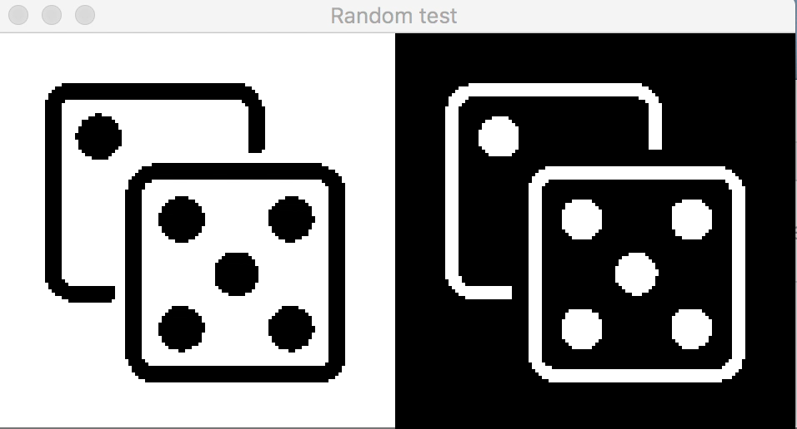

Slide 18
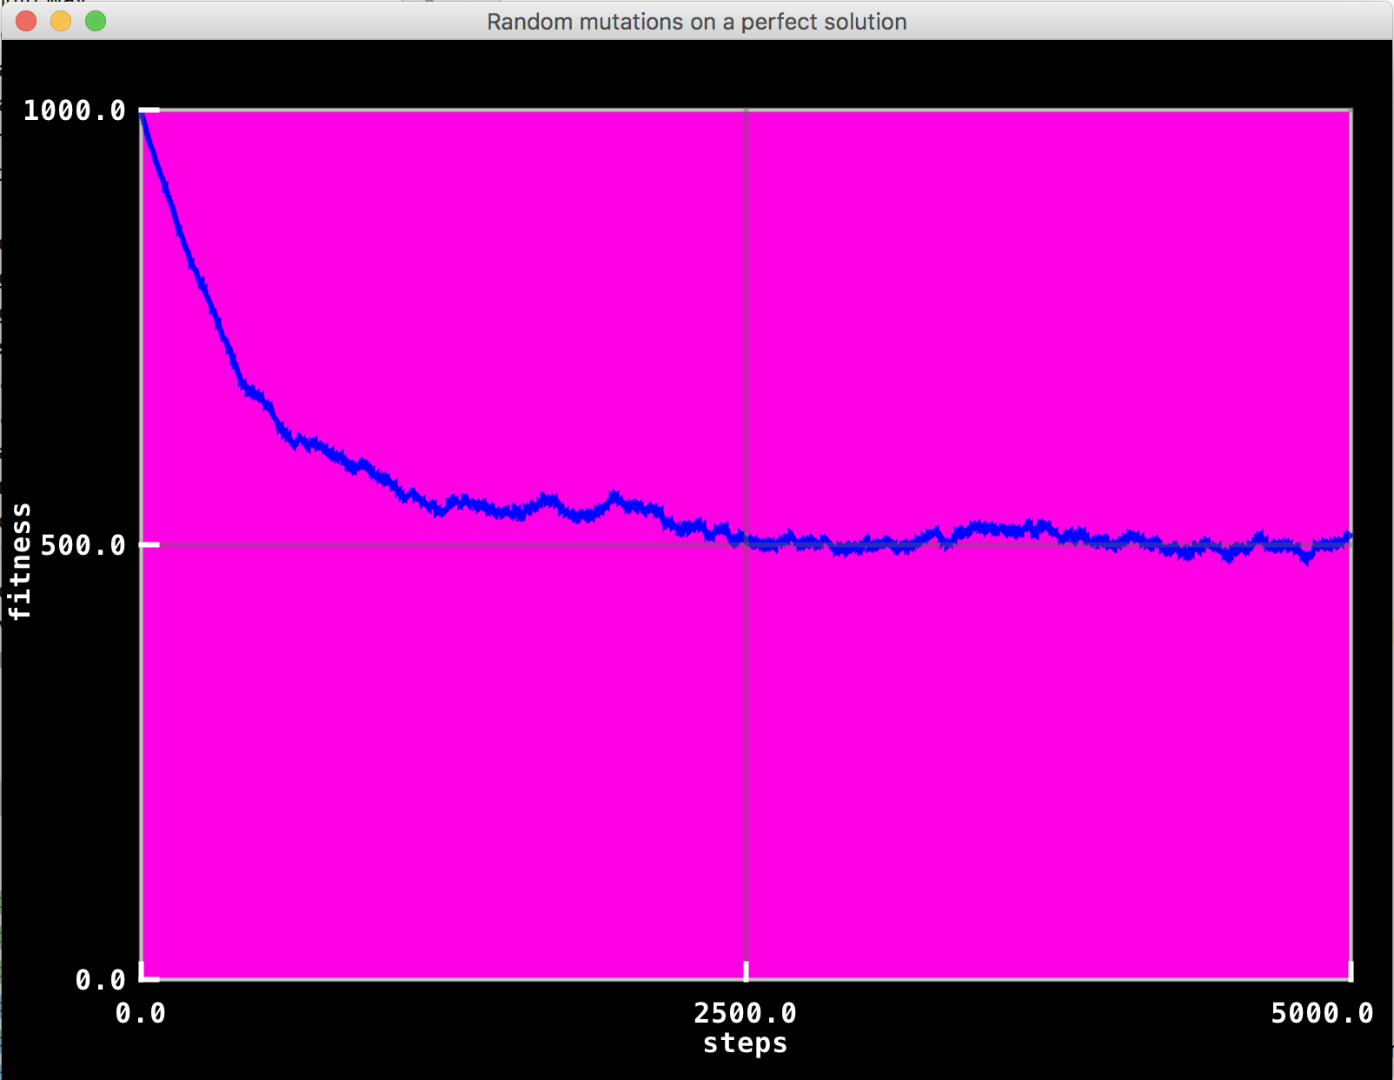
Errors accumulate with random mutations
Notes:
This is just a 1000 dimensional space. Note how initially the graph is steep then it becomes more shallow

Slide 19
So we can turn order into chaos…
But can we turn chaos into order?
Or even evolve something new and brilliant?

Slide 20
YES! Simulated Evolution
Start with randomly generated solutions
Evaluate them (check how good they are)
Generate new ones by mutating best ones
Replace worst with the new ones
Repeat above three steps many times
Notes:
The random solutions will all be TERRIBLE. But some slightly less terrible than others!

Slide 21
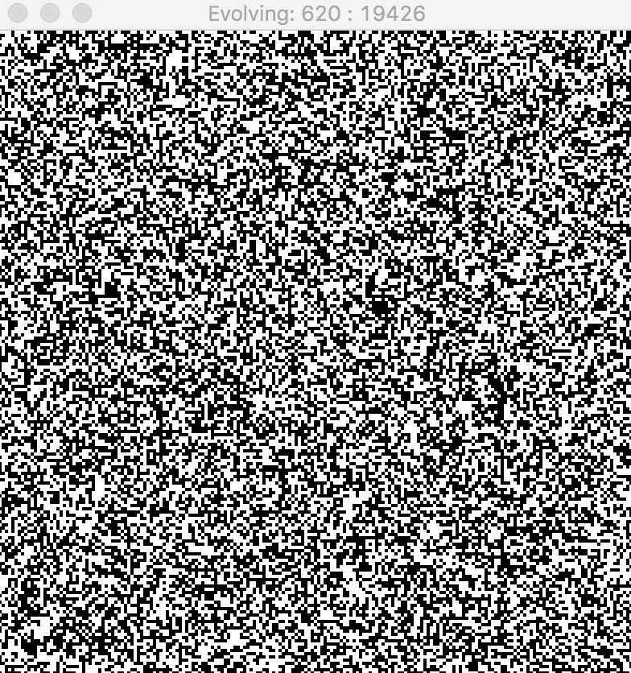
Simple Example: Fitness is based on similarity to a target image How quickly can you recognize it?

Slide 22
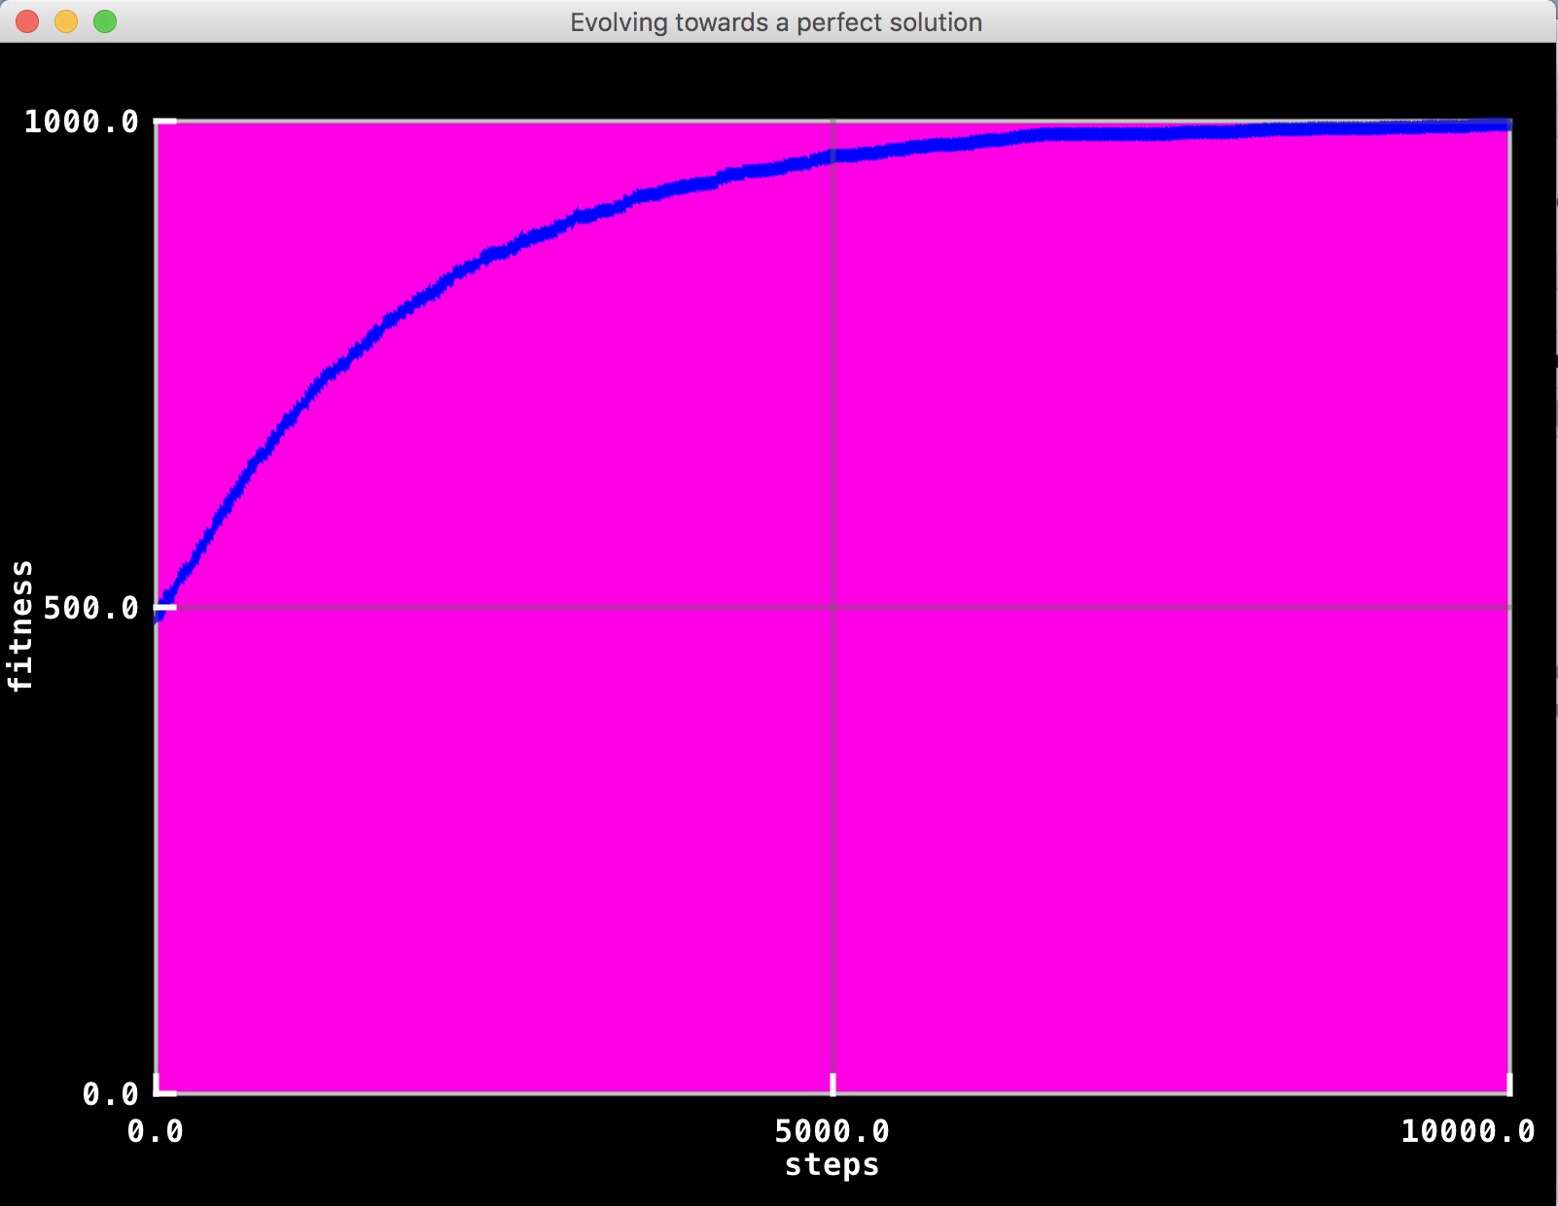
Initial rapid improvements but progress slows as we approach perfection

Slide 23
We can use these principles to create General Game AI
Take copies of the game state
Evolve action sequences to meet best outcomes
Works well across a range of games

Slide 24
How it works
[thrust, turn left, fire, fire, turn left, …] -> +250 points
MUTATE!
[thrust, turn right, fire, fire, thrust, …] -> + 350 points
…
But the actions can be anything in any game –
the algorithm does not care!

Slide 25
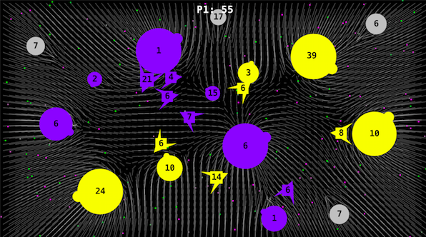
Copy state (20), copy-mutate seq(20), run (20 x 100), score (20), play, shift, repeat
93 [2, 17, 1, 11, 7, 5, 14, 8, 2, 12, 16, 1, 15, 7, 2, 3, 13, 2, 2, 10, 2, 12, 17, 2, 13, 11, 4, 13, 16, 13, 11, 17, 9, 7, 3, 9, 15, 7, 3, 11, 15, 10, 2, 11, 15, 4, 11, 15, 13, 13, 15, 13, 12, 9, 4, 17, 11, 4, 8, 16, 17, 0, 7, 17, 16, 7, 8, 16, 9, 16, 5, 14, 2, 5, 14, 16, 5, 14, 8, 6, 1, 14, 9, 13, 17, 13, 0, 17, 0, 2, 16, 6, 8, 16, 7, 7, 1, 2, 15, 5, 0, 0, 4, 10, 5, 8, 11, 3, 13, 15, 2, 13, 5, 9, 3, 0, 5, 15, 13, 3, 6, 15, 11, 12, 16, 10, 8, 12, 15, 17, 14, 2, 7, 5, 8, 2, 10, 5, 4, 13, 14, 1, 2, 1, 15, 4, 7, 3, 15, 15, 16, 3, 11, 12, 4, 11, 2, 17, 15, 9, 1, 0, 9, 15, 16, 8, 4, 12, 7, 16, 11, 6, 4, 8, 10, 4, 7, 17, 17, 9, 5, 10, 16, 11, 4, 8, 7, 1, 1, 13, 5, 4, 12, 15, 8, 13, 13, 13, 13, 13]
eval
copy
472 [2, 17, 1, 11, 7, 5, 14, 8, 2, 12, 15, 1, 15, 7, 2, 3, 13, 2, 2, 10, 2, 12, 17, 2, 13, 11, 4, 13, 16, 13, 11, 17, 9, 7, 3, 9, 15, 7, 3, 11, 15, 10, 2, 11, 15, 4, 11, 15, 13, 13, 15, 13, 12, 9, 4, 17, 11, 4, 8, 16, 17, 0, 7, 17, 16, 7, 8, 16, 9, 16, 5, 14, 2, 5, 14, 16, 5, 14, 8, 6, 15, 14, 9, 13, 17, 13, 0, 17, 0, 2, 16, 6, 8, 16, 7, 7, 1, 2, 15, 5, 0, 0, 4, 10, 5, 8, 11, 3, 13, 15, 2, 13, 5, 9, 3, 5, 5, 15, 13, 3, 6, 15, 11, 12, 16, 10, 3, 12, 15, 17, 14, 2, 7, 5, 8, 2, 10, 5, 4, 13, 14, 1, 2, 1, 15, 4, 7, 3, 15, 15, 16, 3, 11, 7, 4, 11, 2, 17, 15, 9, 1, 0, 9, 15, 16, 8, 4, 12, 7, 16, 11, 6, 4, 8, 10, 4, 7, 17, 17, 9, 5, 10, 16, 11, 4, 8, 7, 1, 1, 13, 5, 4, 12, 15, 8, 13, 13, 13, 13, 13]
eval
copy

Slide 26
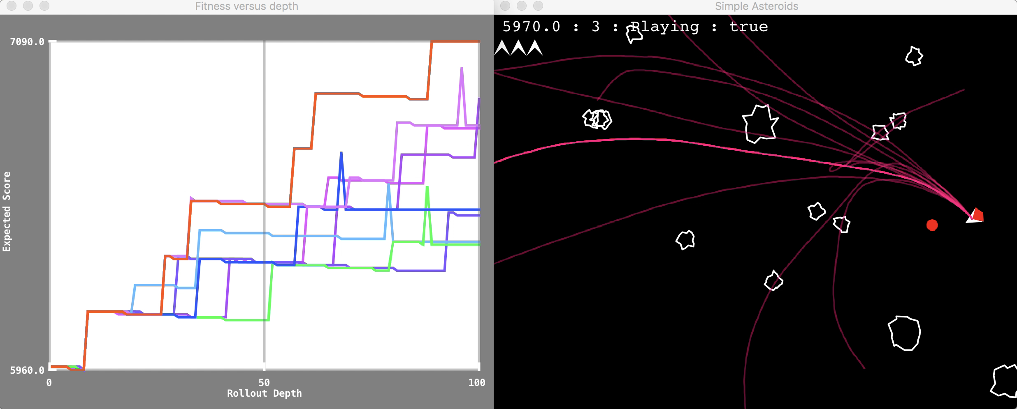
Rolling Horizon Evolution in Asteroids

Slide 27
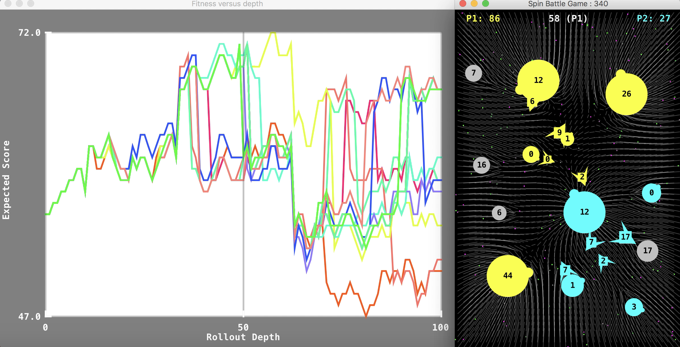
Rolling Horizon Evolution in Planet Wars (each number-pair specifies source and target planets for fleet transits)

Slide 28
Questions?

